Slide 1
Web Technologies
Form Validation

Slide 2
Summary of Today’s Lecture
HTML Form Validation
Client-side vs server-side Validation
Client-side validation approaches
  HTML Built-in Form Validation
  JavaScript based Validation

Slide 3
HTML Form Validation
HTML form Validation is the process to analyze the validity of data client had entered in different form elements. It performs two functions
  Basic Data Validation
    The form must be checked to make sure all the mandatory fields are filled in.
  Data Format Validation
    The data that is entered must be checked for correct form and value.
Validation can happen in two places: in the browser using JavaScript (client-side), and on the server using one of several languages such as PHP (server-side). Client-side validation is preferred due to two reasons.
  It‘s quicker for the user because the form does not need to be sent to the server, processed, and returned to the user with any relevant error messages.
  It saves the load on the server because some errors will get caught before the form is submitted.

Slide 4
Different types of client-side validation
The client-side validation can be categorized into two types:
Built-in form validation:
  It uses HTML5 form validation features, for example, using required attribute.
  This validation generally doesn't require much JavaScript. Built-in form validation has better performance than JavaScript, but it is not as customizable as JavaScript validation.
JavaScript validation is coded using JavaScript.
  This validation is completely customizable, but you need to create it all (or use a library).
  For example, you can write your own JavaScript validation file (JSValidate.js).
  Or you can use already developed third party libraries, such as, JQuery Validation Plugin, Parsely etc.

Slide 5
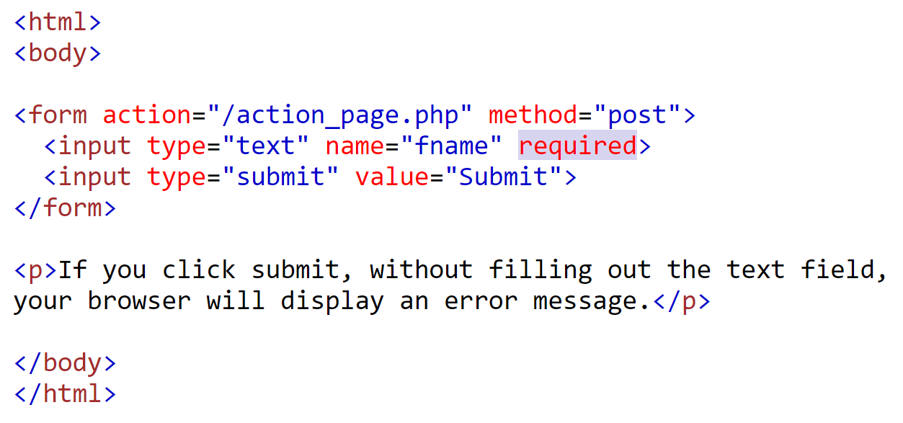
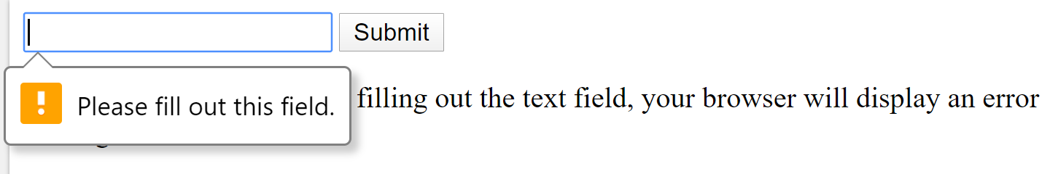
Built-in form validation – the required attribute
The simplest HTML5 validation feature is the required attribute.
The input required attribute specifies that an input field must be filled out before submitting the form.
The required attribute works with the following input types: text, search, url, tel, email, password, date pickers, number, checkbox, radio, and file. It also works on the <select> and <textarea> elements.
If a form field (fname) is empty, the required attribute prevents this form from being submitted:

Slide 6
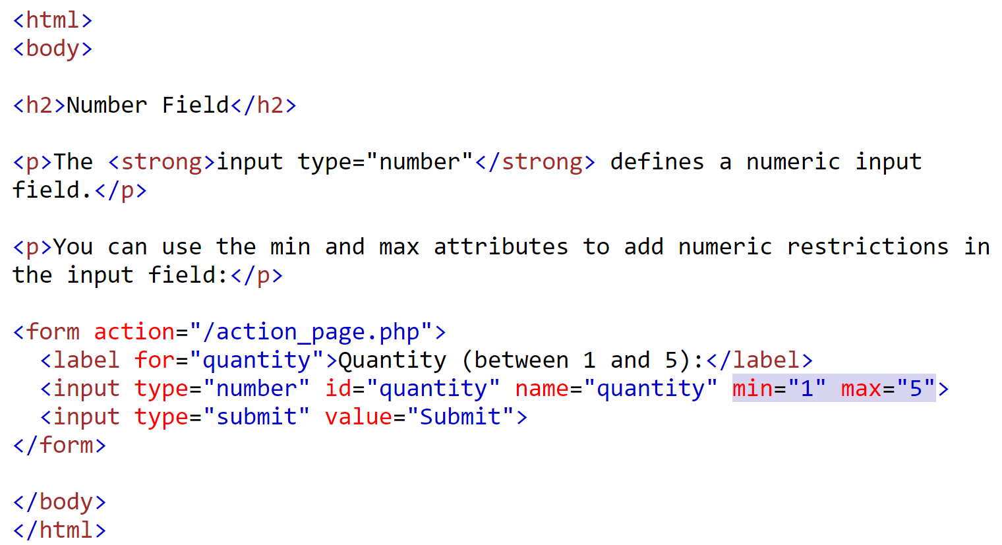
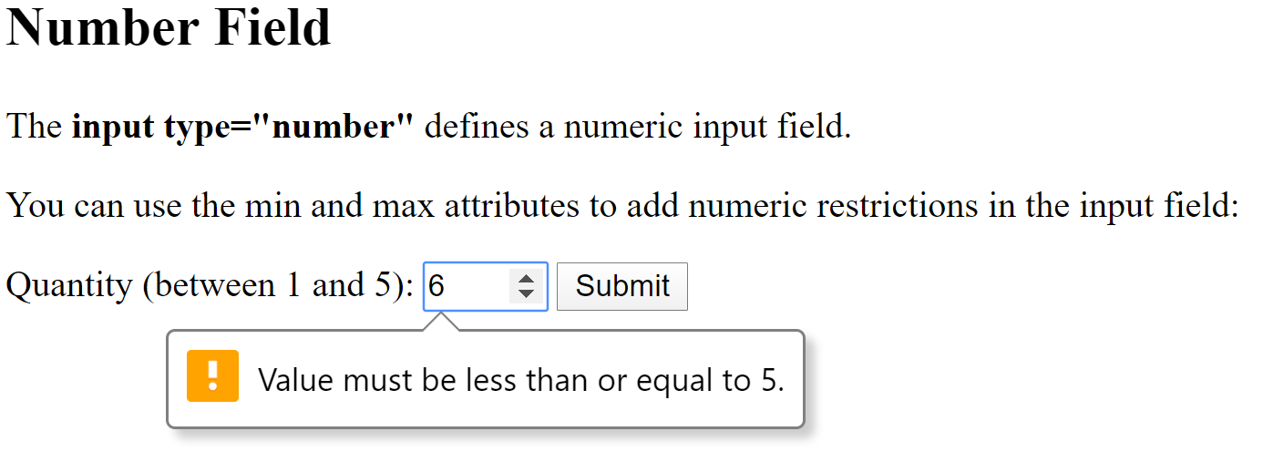
Built-in form validation – the min & max attributes
The input min and max attributes specify the minimum and maximum range of an input field.
If the field contains a value outside this range, it will automatically generate an error.
The min and max attributes work with the following input types: number, range, date, datetime-local, month, time and week.
The following example displays a numeric input field, where you can enter a value from 1 to 5:

Slide 7
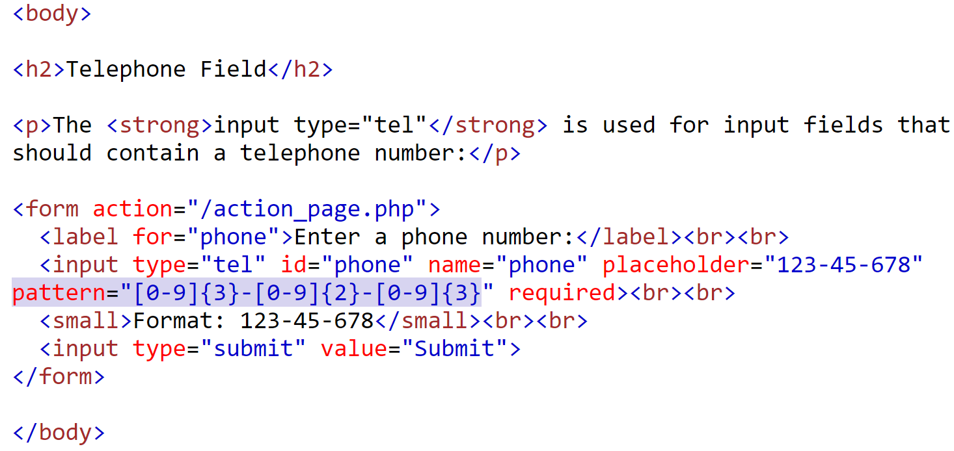
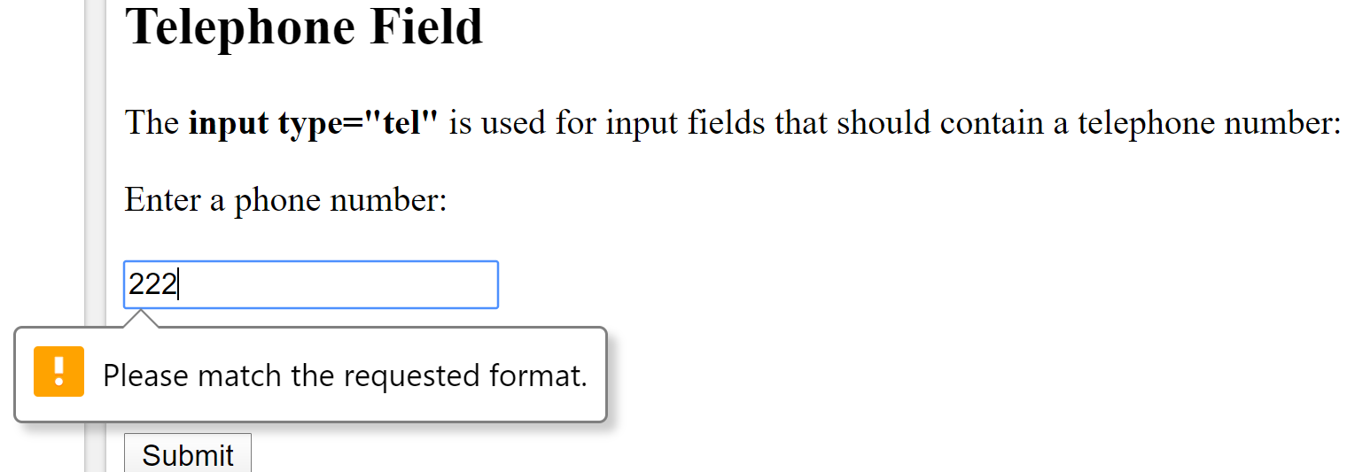
Built-in form validation – the pattern attribute
The input pattern attribute specifies a regular expression that the input field's value is checked against, when the form is submitted.
The pattern attribute works with the following input types: text, date, search, url, tel, email, and password.
For example, the following example ensures the proper format of a telephone number.

Slide 8
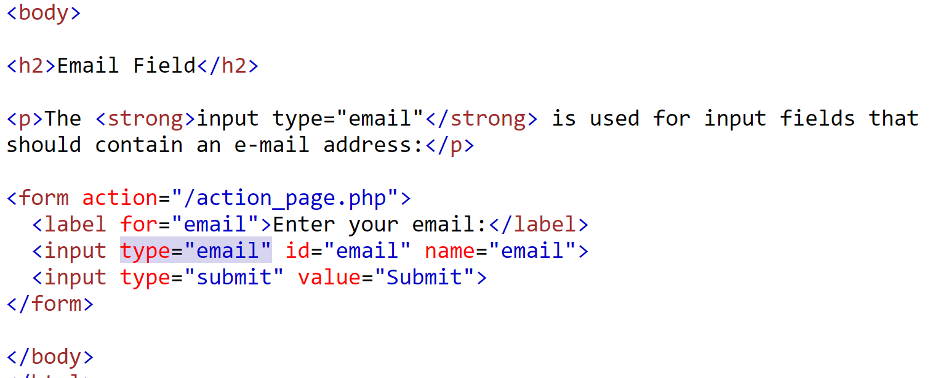
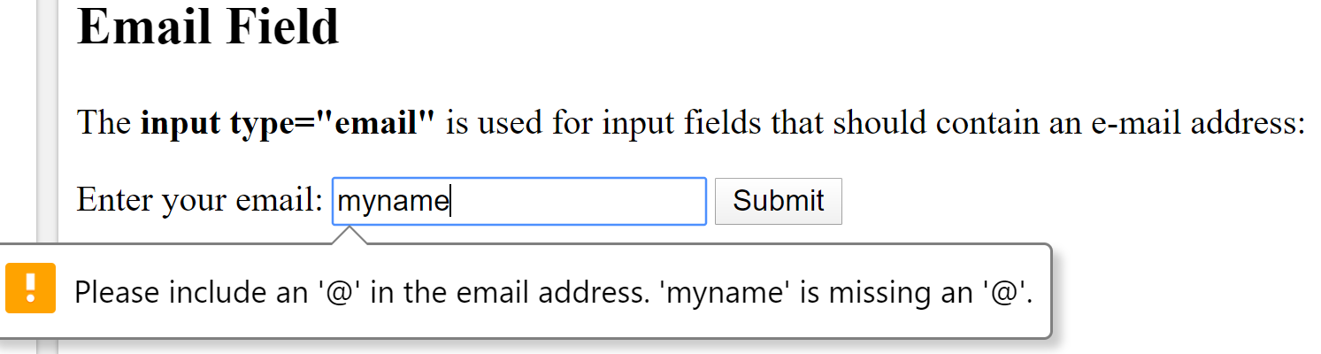
Built-in form validation – the type attribute
The type="email" and type="url" are used for input fields that should contain an e-mail address and url respectively.
Depending on browser support, the e-mail address and url can be automatically validated when submitted.
For example, the following raises an error message if email is not added in the proper format.

Slide 9
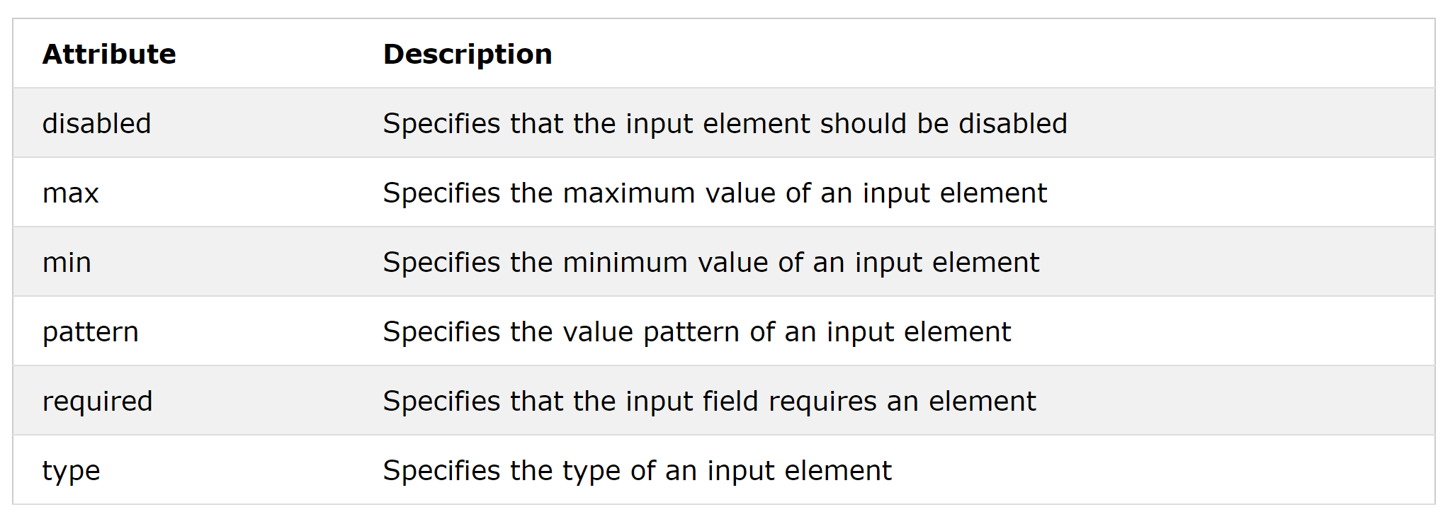
Built-in form validation
(Validation-related Attributes)
The following attributes are used to describe basic constraints:

Slide 10
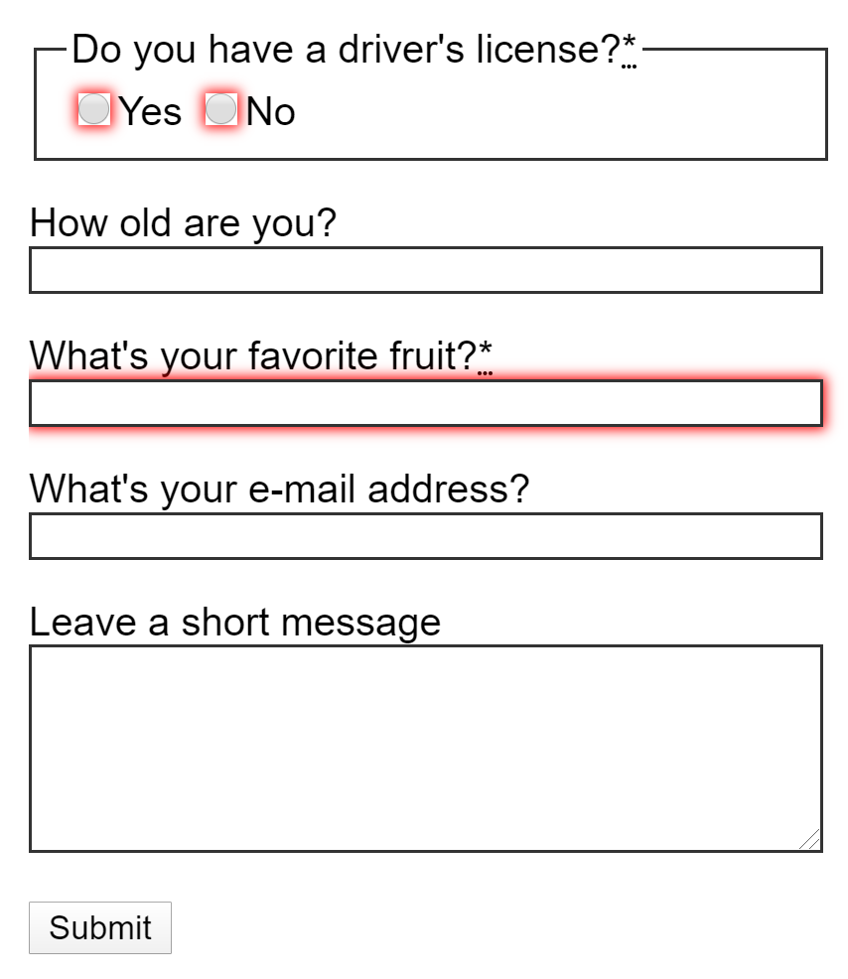
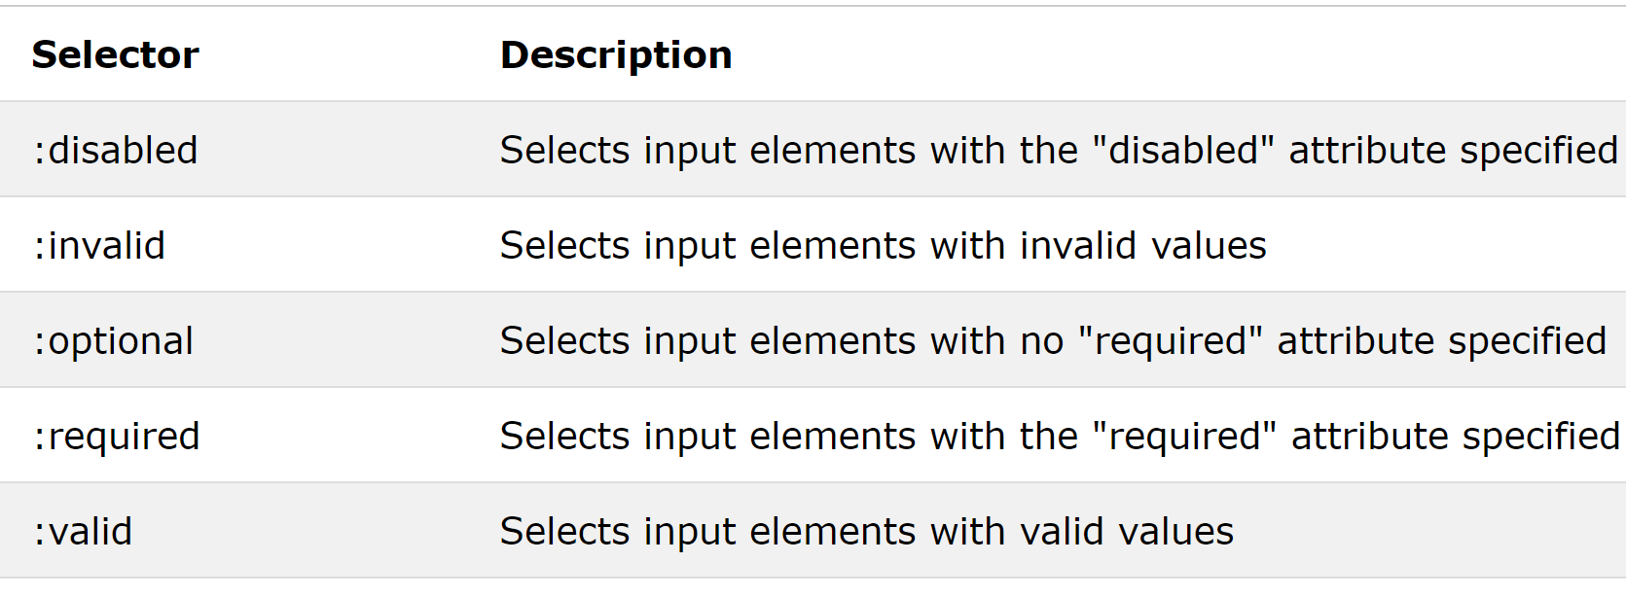
Built-in form validation - Controlling the look of elements (CSS Pseudo-class Selectors)
The look of elements can be controlled via CSS pseudo-classes.
  The :required and :optional pseudo-classes allow writing selectors that match form elements that have the required attribute, or that don't have it.
  The :valid and :invalid pseudo-classes are used to represent <input> elements whose content validates and fails to validate respectively according to the element's settings.
  The :valid and :invalid selector only works for form elements with limitations, such as input elements with min and max attributes, email fields with a legal email, or number fields with a numeric value, etc.
  These classes allow the user to style valid or invalid form elements to make it easier to identify elements that are either formatted correctly or incorrectly.

Slide 11
Validating forms using JavaScript
We must use JavaScript if we want to take control over the look and feel of native error messages or to deal with legacy browsers that do not support HTML's built-in form validation.
When the user presses the submit button on a form, it triggers the onsubmit event handler on the <form> element.
This calls a validation function stored either in a separate script or in the head of the document.
The function must then return true in order for the form to be sent, or, if an error is encountered, the function returns false and the user ’s form will not be sent.
If the error is generated, the form should indicate to the user where there is a problem with the information the user entered.

Slide 12
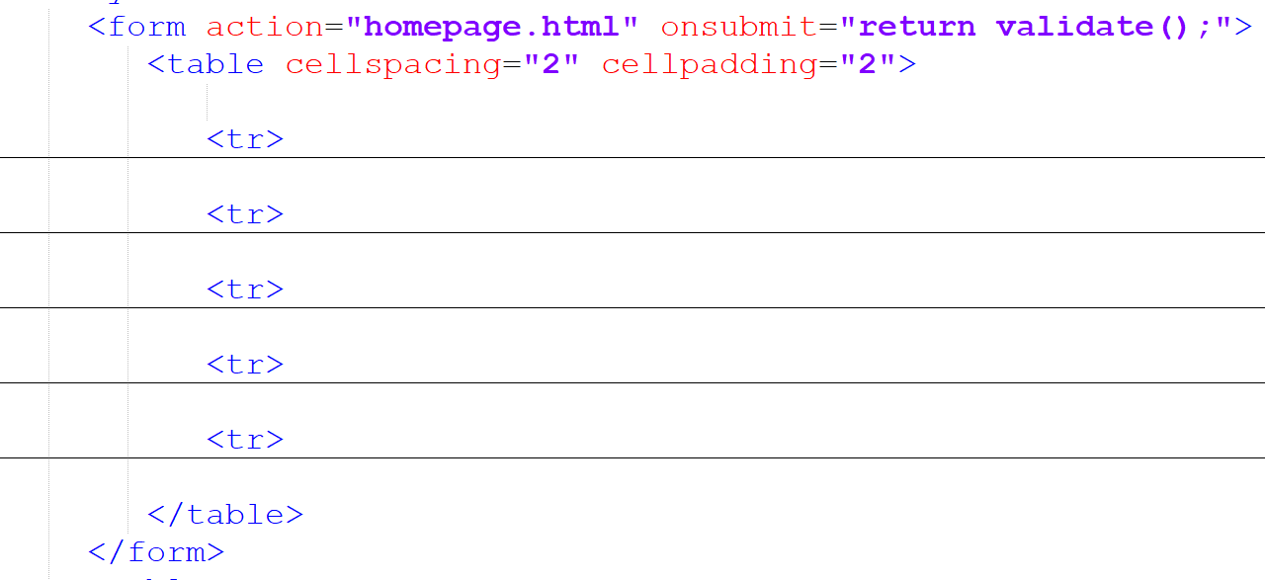
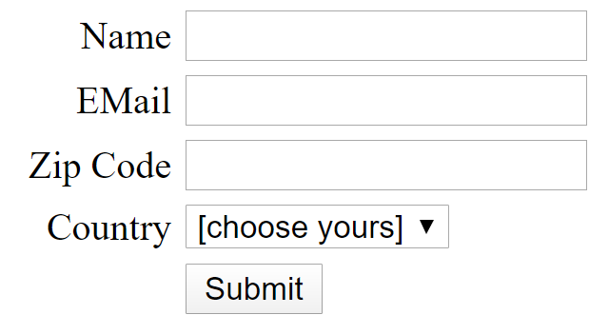
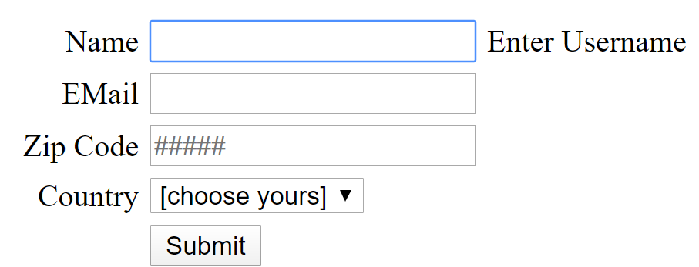
Basic Data Validation – Example
HTML Form
Form Output
Error Msg Display

Slide 13
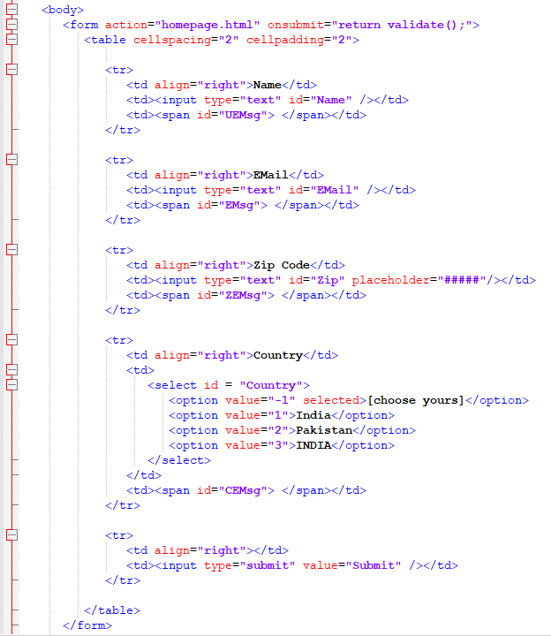
Detailed HTML Form
Error Msg Display

Slide 14
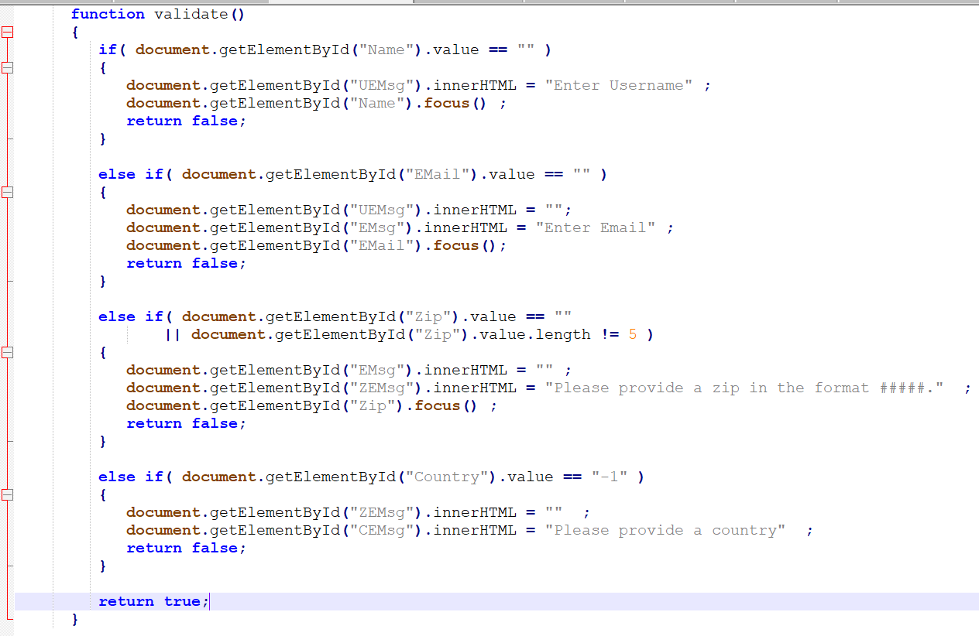
JS validate() method
Error Msg Display

Slide 15
Regular Expressions
A regular expression is a sequence of characters that forms a search pattern.
When you search for data in a text, you can use this search pattern to describe what you are searching for.
Regular expressions can be used to perform all types of text search and text replace operations.
The JavaScript RegExp class represents regular expressions, and both String and RegExp define methods that use regular expressions to perform powerful pattern-matching and search-and-replace functions on text.
A regular expression could be defined with the RegExp() constructor, as follows:
  var pattern = new RegExp(pattern, modifiers);
  or simply
  var pattern = /pattern/modifiers;
Here is the description of the parameters:
  pattern − A string that specifies the pattern of the regular expression or another regular expression.
  modifiers − An optional string containing any of the "g", "i", and "m" modifiers that specify global, case-insensitive, and multi-line matches, respectively.

Slide 16
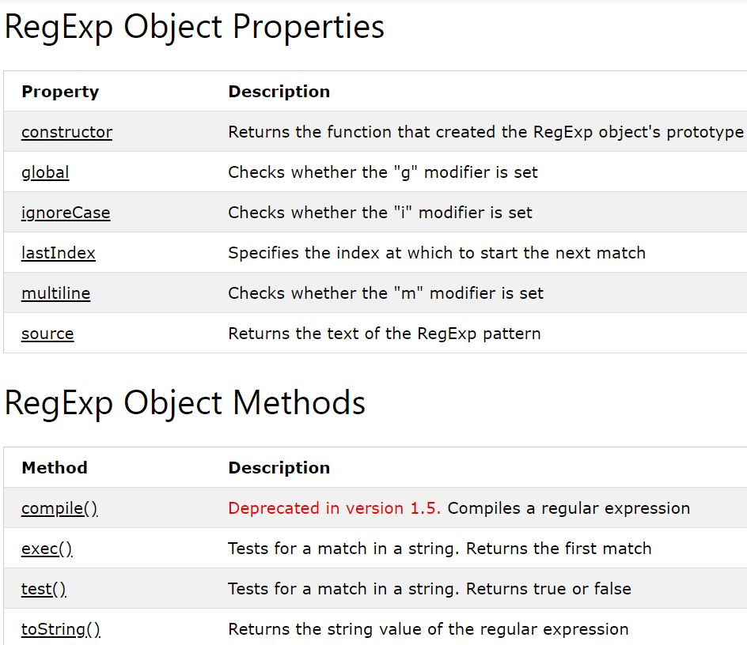
Regular Expression Properties/ Methods

Slide 17
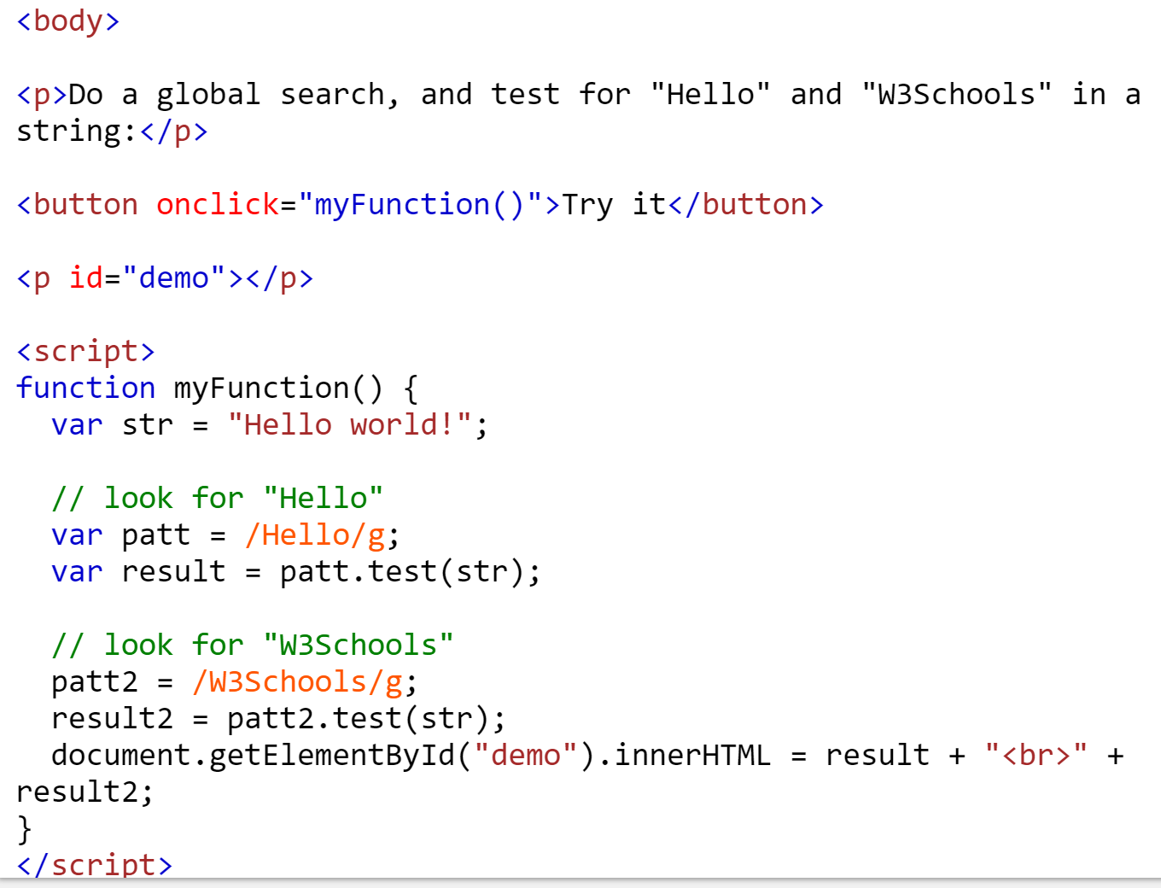

test()method
The test()method tests for a match in a string. This method returns true if it finds a match, otherwise it returns false.

Slide 18
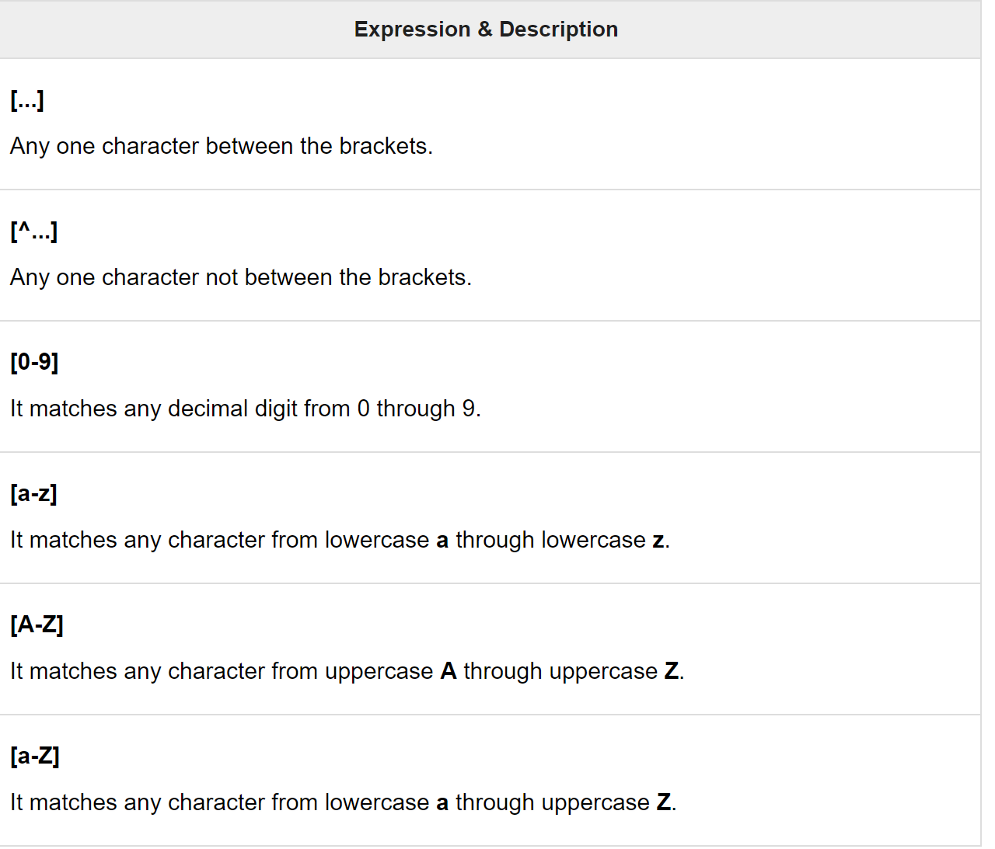
Regular Expression Patterns
Brackets ([]) are used to find a range of characters:
Example:
[^a-zA-Z]
It matches any string not containing any of the characters ranging from a through z and A through Z.

Slide 19
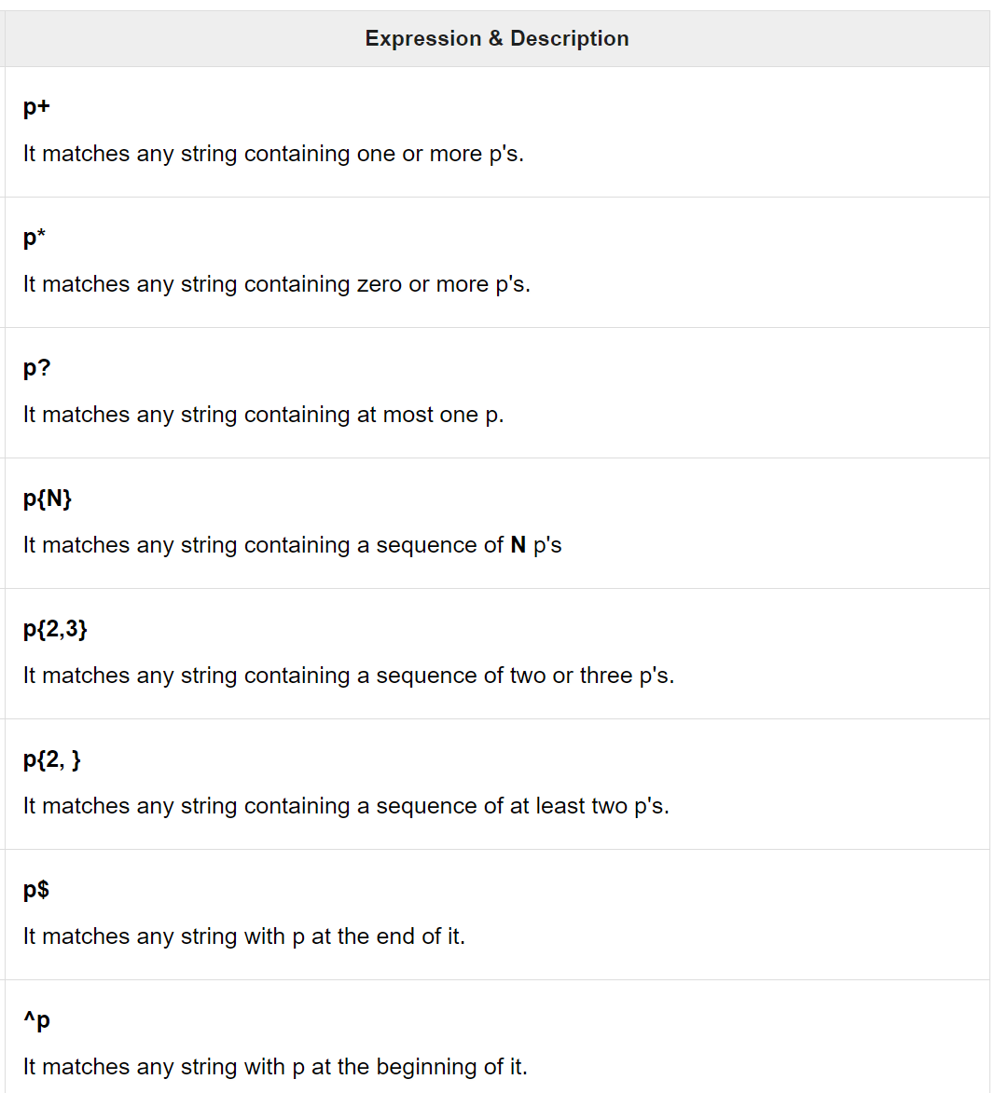
Regular Expression Quantifiers
Quantifiers define quantities. It defines frequency or position of bracketed character sequences and single characters can be denoted by a special character.
Each special character has a specific connotation. The +, *, ?, and $ flags all follow a character sequence.
Example: p(hp)* It matches any string containing a p followed by zero or more instances of the sequence hp.

Slide 20
Regular Expression Examples
Telephone must be a valid 11 digits number.
  /^[0-9]{11}$/
Username must contain 5 - 12 characters
  /^[0-9a-z]{5,12}$/i
Password must be alphanumeric (@, _ and - are also allowed) and be 8 - 20 characters
  /^[0-9a-z@-_]{8,20}$/
Email must be a valid address, e.g. me@mydomain.com {.uk}
  /^([a-z0-9\.-]+)@([a-z0-9-]+)\.([a-z]{2,8})(\.[a-z]{2,8})?$/
  me@mydomain.com {.uk}
For testing regular expressions, use the following URL,
https://regex101.com/r/CmSol8/1/

Slide 21
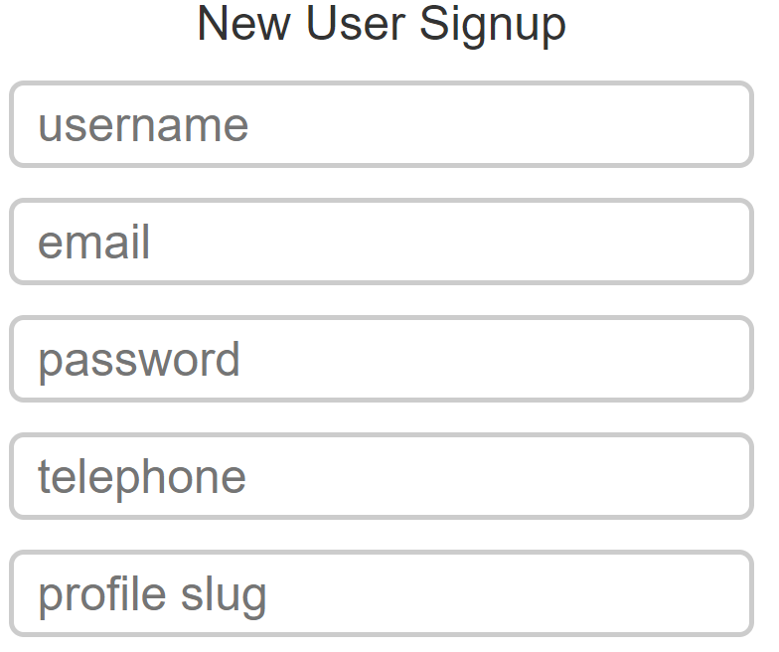
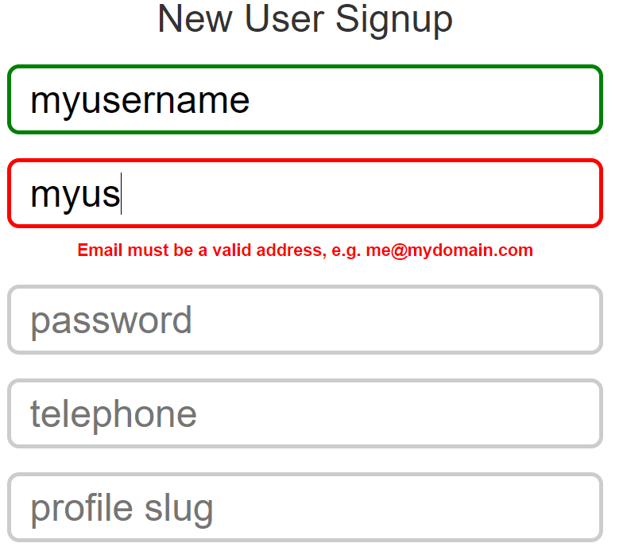
Data Format Validation – Example

Slide 22
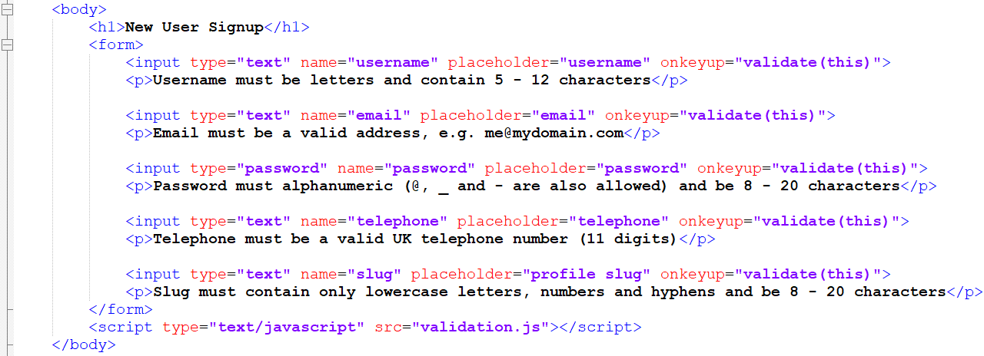
Data Format Validation – Example
HTML Form

Slide 23
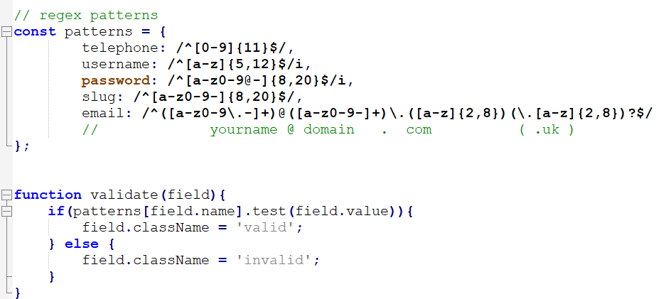
Data Format Validation – Example
Validation.js

Slide 24
Summary of Today’s Lecture
HTML Form Validation
Client-side vs server-side Validation
Client-side validation approaches
  HTML Built-in Form Validation
  JavaScript based Validation

Slide 25
Resources
Chapter 12 from Beginning HTML, XHTML, CSS and JavaScript By John Duckett(4th Edition)
https://www.tutorialrepublic.com/javascript-tutorial/javascript-form-validation.php
https://developer.mozilla.org/en-US/docs/Learn/Forms/Form_validation
https://www.w3schools.com/js/js_validation.asp
https://www.w3schools.com/js/js_validation_api.asp
https://developer.mozilla.org/en-US/docs/Web/Guide/HTML/HTML5/Constraint_validation
https://jqueryvalidation.org/

